Slide 1
Masters Of C#

Slide 2
Opzet
Naar aanleiding van MOJ (Masters Of java)
  http://mastersofjava.2en40.nl/About.html

Slide 3
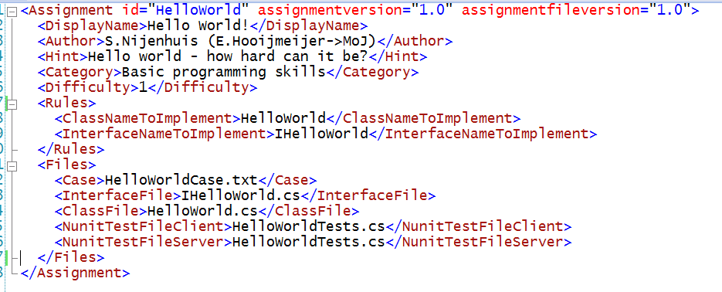
Uitbreidbare opdrachten
Casus (text)
Interface file
Lege implementatie
Unit Tests (Client)
Unit Tests (Server)

Slide 4
Componenten
MoCS.Client
MoCS.Client.Business.Entities
MoCS.BuildService
MoCS.Client.Business
MoCS.BuildService.Business
MoCS.Client.Data

Slide 5
Componenten
MoCS.Client
MoCS
.Messaging.Entities
net.tcp
MoCS.Service.Host
MoCS.Client.
Business.Entities
MoCS.BuildService
MoCS.Client.Business
MoCS.BuildService.Business
MoCS.Client.Data

Slide 6
Opdrachten
Very Easy
  HelloWorld
  FizzBuzz
  MonkeyAcademy (sum parsing)
Easy
  ThePostmanNeverWalksTwice

Slide 7
Buildserver
Poll voortdurend op nieuwe submits in de repository
Voorbereiding
  Maak eigen directory aan per submit
  Kopieer de server bestanden naar directory
Build
  Schrijf batchfile voor CSC.exe
  Start de batchfile
  Controleer dat de build gelukt is
Valideer Businessrules
  Controleer dat interface wordt geimplementeerd
  Controleer dat classname wordt geimplementeerd
Unit Tests
  Schrijf batchfile voor NUnit.Console.exe
  Start de batchfile
  Lees de log
Rapportage
  Schrijf het buildresultaat terug naar de repository

Slide 9
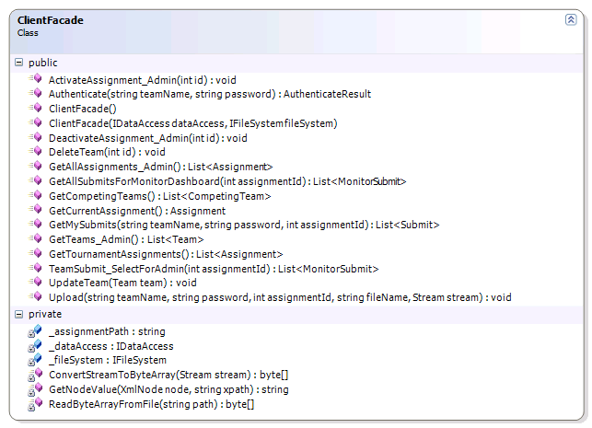
MoCs.Client.Business

Slide 10
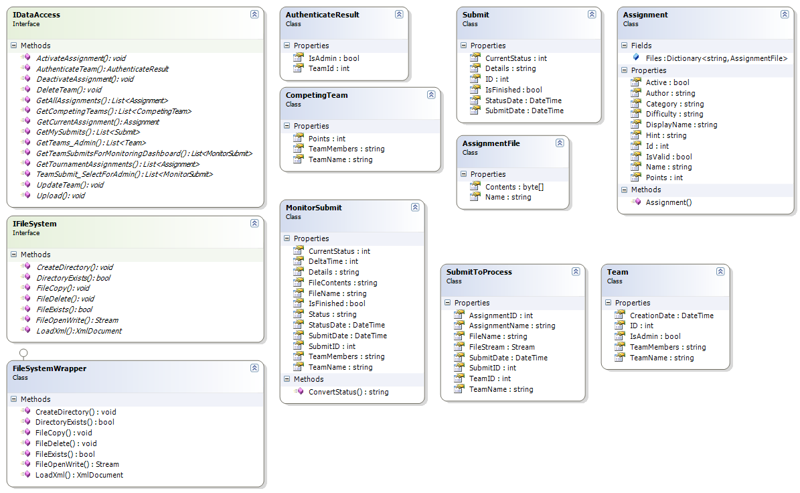
MoCs.Client.Business.Entities

Slide 11
Scenario 1 & 2
public class HelloWorld
{
public string SayIt(string name)
{
if (name != null && name.Length > 0)
{
return "Hello " + name;
}
else
return "Hello";
}
}
public class HelloWorld
{
public string SayIt(string name)
{
if (name != null && name.Length > 0)
{
return "Hello " + name
}
else
return "Hello";
}
}
"C:\WINDOWS\Microsoft.NET\Framework\v3.5\csc.exe" /out:HelloWorld.dll /nologo /target:library HelloWorld.cs >build.log
Build.log
Build.log
HelloWorld.cs(7,35): error CS1002: ; expected
Assembly HelloWorld.dll
No Assembly

Slide 12
Scenario 3 & 4
public class MyXmlReader
{
public void DoIt()
{
XmlDocument doc = new XmlDocument();
}
}
using System.Xml;
public class MyXmlReader
{
public void DoIt()
{
XmlDocument doc = new XmlDocument();
}
}
"C:\WINDOWS\Microsoft.NET\Framework\v3.5\csc.exe" /out:MyXmlReader.dll /nologo /target:library MyXmlReader.cs >build.log
Build.log
MyXmlReader.cs(5,9): error CS0246: The type or namespace name 'XmlDocument' could not be found (are you missing a using directive or an assembly reference?)
MyXmlReader.cs(5,31): error CS0246: The type or namespace name 'XmlDocument' could not be found (are you missing a using directive or an assembly reference?)

Slide 13

Scenario 5
using System.Drawing;
using System.Windows.Forms;
public class MyImage
{
public void DoIt()
{
Image image = new Bitmap(typeof(Button), "Button.bmp");
}
}
"C:\WINDOWS\Microsoft.NET\Framework\v3.5\csc.exe" /out:MyImage.dll /nologo /target:library MyImage.cs >build.log
Build.log
Assembly MyImage.dll

Slide 14
public class HelloWorld : IHelloWorld
{
public string SayIt(string name)
{
if (name != null && name.Length > 0)
{
return "Hello " + name;
}
else
return "Hello";
}
}
public interface IHelloWorld
{
string SayIt(string name);
}
"C:\WINDOWS\Microsoft.NET\Framework\v3.5\csc.exe" /out:HelloWorld.dll /nologo /target:library HelloWorld.cs >build.log
HelloWorld.cs(1,27): error CS0246: The type or namespace name 'IHelloWorld' could not be found (are you missing a using directive or an assembly reference?)
"C:\WINDOWS\Microsoft.NET\Framework\v3.5\csc.exe" /out:HelloWorld.dll /nologo /target:library HelloWorld.cs IHelloWorld.cs >build.log
Of met een wildcard
"C:\WINDOWS\Microsoft.NET\Framework\v3.5\csc.exe" /out:HelloWorld.dll /nologo /target:library *.cs >build.log

